Slide 1
Summer Food Service Program
PY24 Budget Detail
CACFP and SFSP Compensation
Instructions on how to enter an employee’s annual compensation when the employee works in both CACFP and SFSP.
Complete the SFSP Budget Detail.
SFSP pay should not equal more than 30% of total annual pay. (SFSP should not exceed a total aggregate of four months.)
Additional Costs and/or Benefits (Benefit Calculator) may be 100% allocated under CACFP or can be allocated between CACFP and SFSP. SFSP allocation should not exceed 30% of total.
Complete the CACFP Budget Detail.
CACFP/SFSP Salary Worksheet no longer required.
Submit both CACFP and SFSP budgets for review at the same time.
Do not submit any other changes to the CACFP application if possible as additional items submitted for review will lengthen processing times.

Slide 2
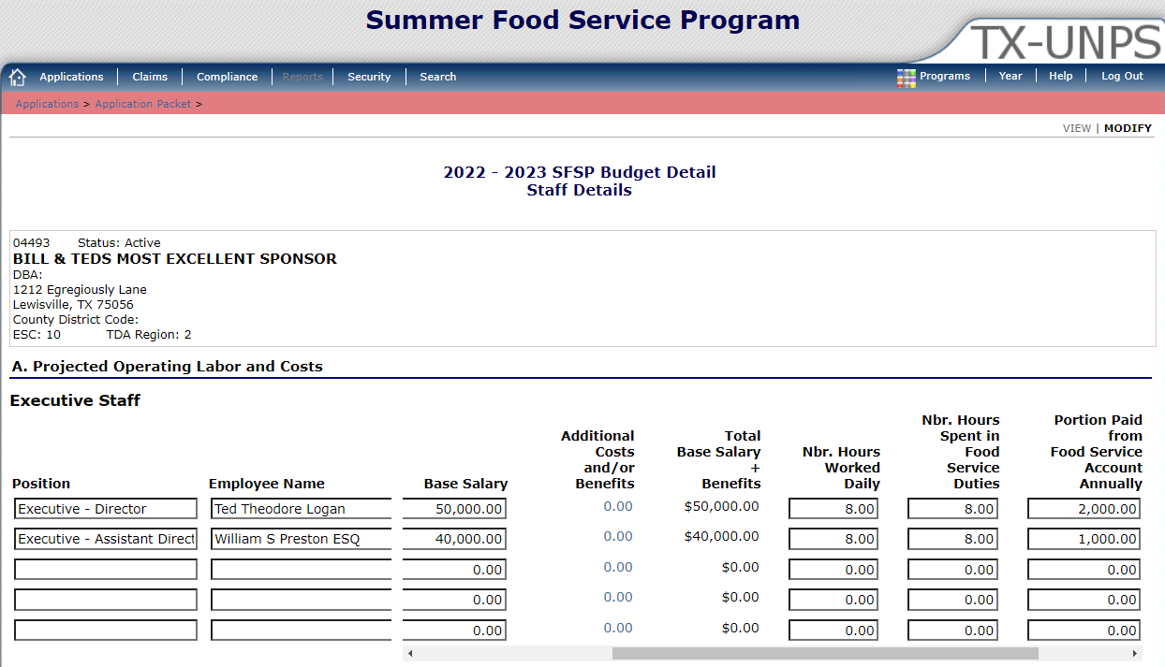
PY24 Budget Detail
SFSP Compensation
SFSP Staff Details: TX-UNPS Expectations
Position | Enter Taxable Income Protocol category for each position.
Based Salary | List the same amount in both SFSP and CACFP budgets.
Nbr. Hours Worked Daily | Full time employees should reflect a minimum of 7 hours.
Nbr. Hours Spent in Food Service Duties | This should reflect the number of hours typically worked in a day operating the SFSP.
Portion Paid from Food Service Account Annually | If employee paid only with program funds, amount listed under both budgets should total to equal Base Salary + Additional Costs and/or Benefits.

Slide 3
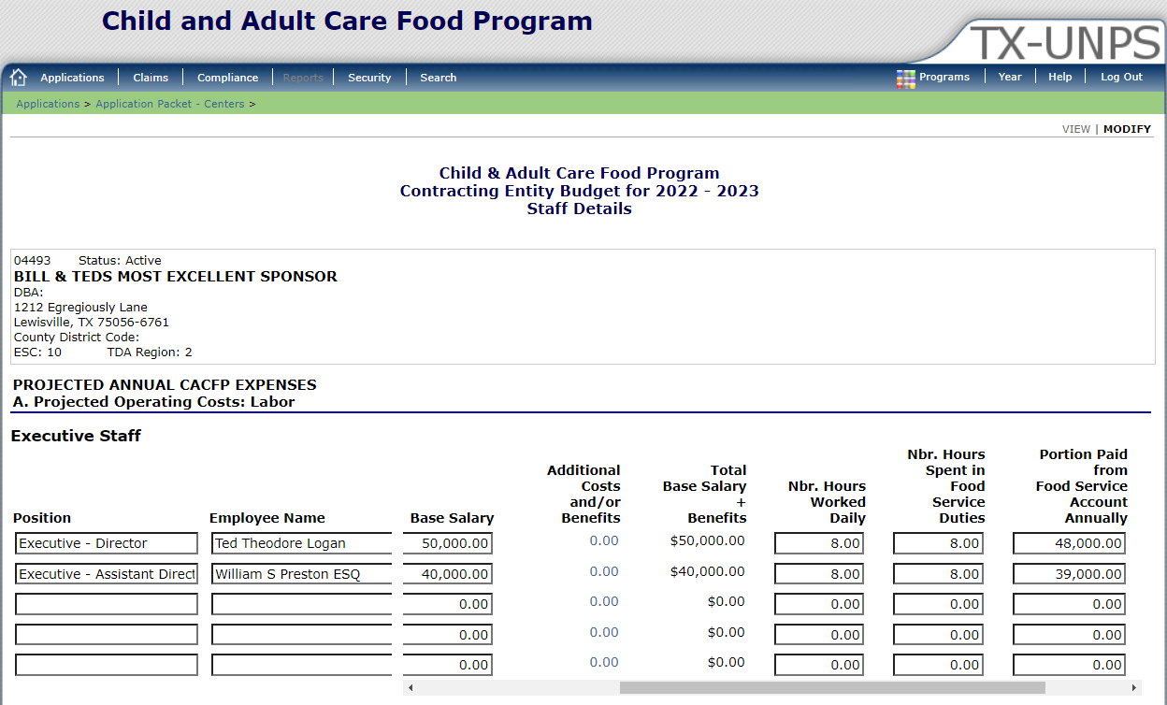
PY24 Budget Detail
CACFP Compensation
CACFP Staff Details: TX-UNPS Expectations
Position | Enter Taxable Income Protocol category for each position.
Based Salary | List the same amount in both SFSP and CACFP budgets.
Nbr. Hours Worked Daily | Full time employees should reflect a minimum of 7 hours.
Nbr. Hours Spent in Food Service Duties | This should reflect the number of hours typically worked in a day operating the CACFP.
Portion Paid from Food Service Account Annually | If employee paid only with program funds, amount listed under both budgets should total to equal Base Salary + Additional Costs and/or Benefits.

Slide 4
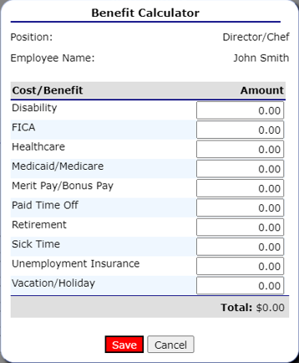
Summer Food Service Program
PY24 Budget Detail
Benefit Calculator and Compensation Review
BENEFIT CALCULATOR
Complete the Benefit Calculator per your organizations compensation policy.
Additional Costs and/or Benefits may be 100% allocated for CACFP or allocated between both programs. SFSP allocation should not exceed 30% of total amount.
COMPENSATION REVIEW
All compensation will be calculated and based on the amounts listed in the CACFP Compensation Protocol.
Compensation must be in accordance with the organization’s Compensation Policy.
TDA may request more information to determine all costs are reasonable, necessary and allocable to the food programs.

